Slide 1
Personalizing Learning Through Work
Cassie Palsgrove
Notes:
Welcome to the overview for the policy on career advising. My name is Carolyn George, Career Connections Administrator at the Ohio Dept of Ed.

Slide 2
Success in the New Economy

Slide 3
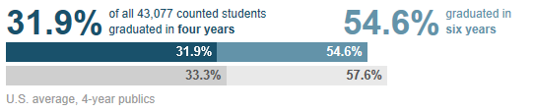
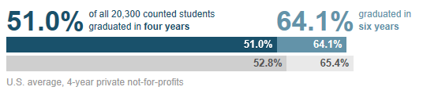
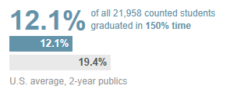
2013 College Completion Rates
Ohio public colleges (4-year)
Ohio private colleges (4-year)
Ohio public colleges (2-year)
Source: https://collegecompletion.chronicle.com/state/#state=OH&sector=public_four

Slide 4
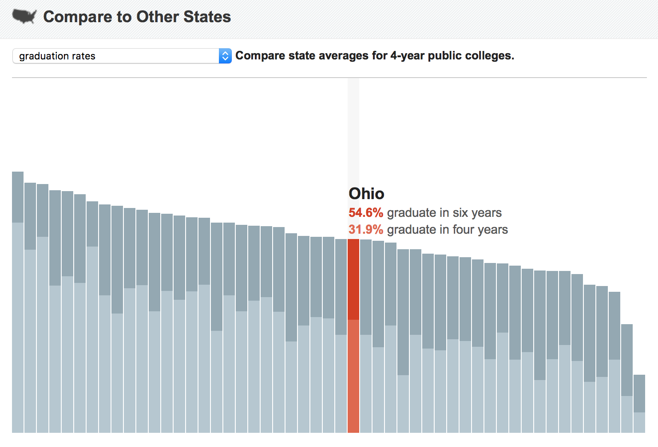
How do we compare?

Slide 5
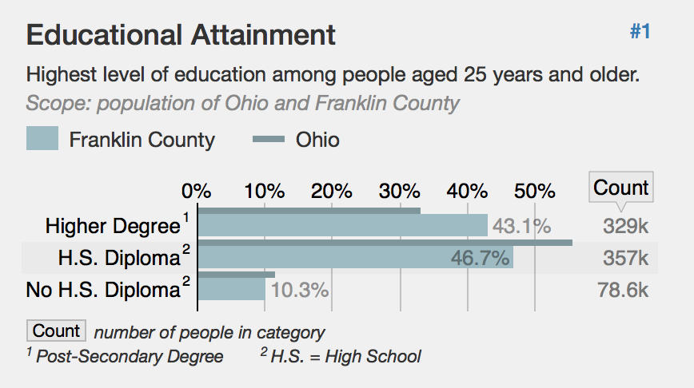
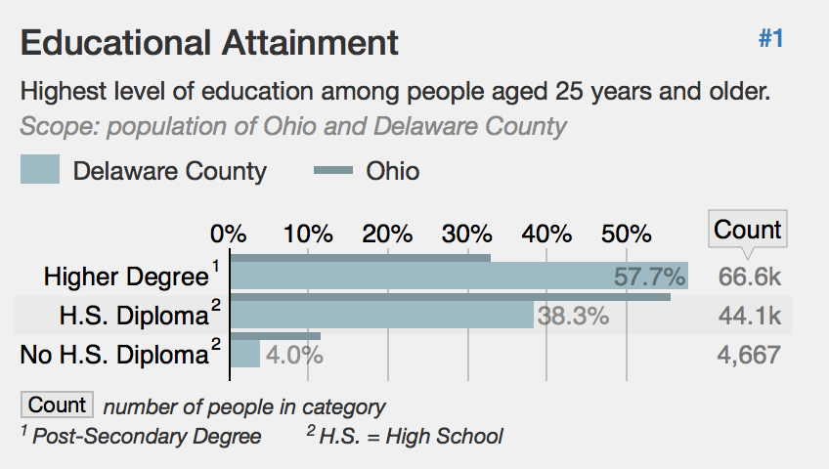
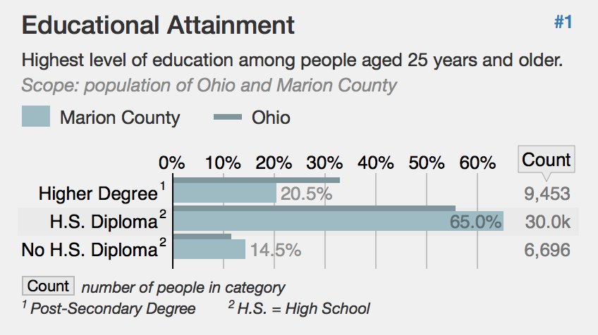
Education Attainment
Source: https://statisticalatlas.com/state/Ohio/Educational-Attainment

Slide 6
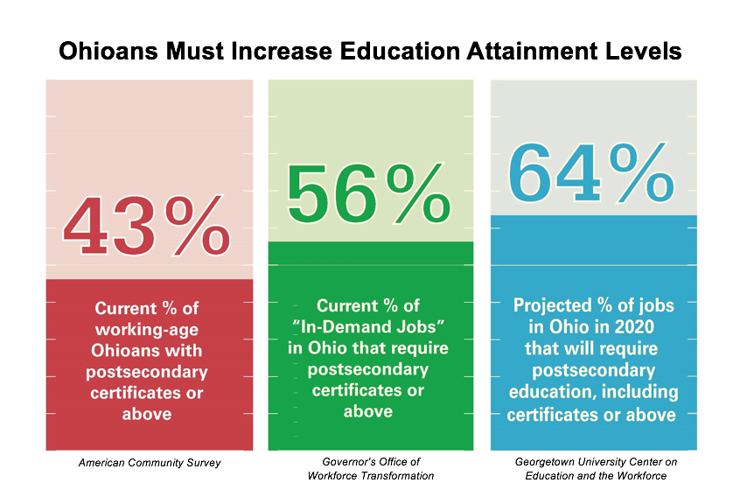

Slide 7
Postsecondary Credentials
What is a postsecondary credential?
  Associate’s Degree
  Bachelor’s Degree
  Industry recognized credential
  Can attain or make progress on while in high school and beyond

Slide 8
Goal for EachChild
Annually increase the percentage of Ohio’s high school graduates who, within one year of graduation, are:
Enrolled and succeeding in a post-high school learning experience, including an adult career-technical education program, an apprenticeship and/or a two-year or four-year college program (15 semester hours); or
Serving in a military branch; or
Earning a living wage.
From Ohio’s Strategic DRAFT Plan for Education

Slide 9
How do we get there?
Notes:
One option for accomplishing this is through credit flex, where academic credit may be earned in flexible ways through options described in existing school policy.
The second option is for the district to allow students to meet a graduation requirement through a course that integrates both career-tech and academic content.

Slide 10

SuccessBound
“Getting kids excited about job opportunities can begin to capture their imagination. By connecting employers with qualified workers, we’re changing the lives of our students and strengthening Ohio’s economy.” – Gov. Kasich

Slide 11



Slide 12
Career Pathways
Career pathways are a sequence of integrated courses and experiences that develop a student’s academic, technical, and professional skills aligned to their career area of interest. Career pathways connect students to credential(s), further education or training necessary, and ready students for high-opportunity careers.

Slide 13

Align Stages of Learning
High School
Work
Learning
College

Slide 14

Industry Credentials are Important for All Students

Slide 15
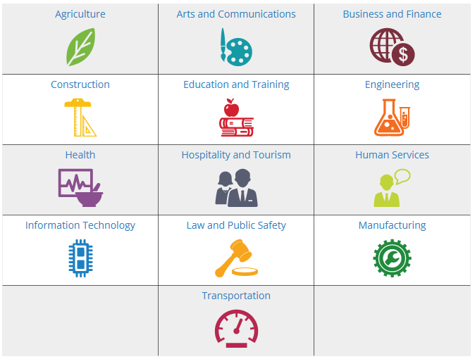
Industry-recognized Credentials
Students can choose from 13 career fields.
Notes:
INDUSTRY-RECOGNIZED CredentiaLS
Students can choose from 13 career fields.

Slide 16

Academic and Technical Credit
Credit Flex
Integrated credit
Notes:
One option for accomplishing this is through credit flex, where academic credit may be earned in flexible ways through options described in existing school policy.
The second option is for the district to allow students to meet a graduation requirement through a course that integrates both career-tech and academic content.

Slide 17
Credit Flexibility
gives students a personalized way to guide their learning
provides equitable access to various course options to all students throughout the state of Ohio.
Notes:
While using OhioMeansJobs K-12 is not required, it is encouraged as a quality no-cost tool available to all districts. Online training and support materials are available on the dept’s website.
The dept has also development sample pathway documents that help align education and training to related careers. These pathways can be customized according to school course offerings as well as individual student plans for high school and beyond.

Slide 18
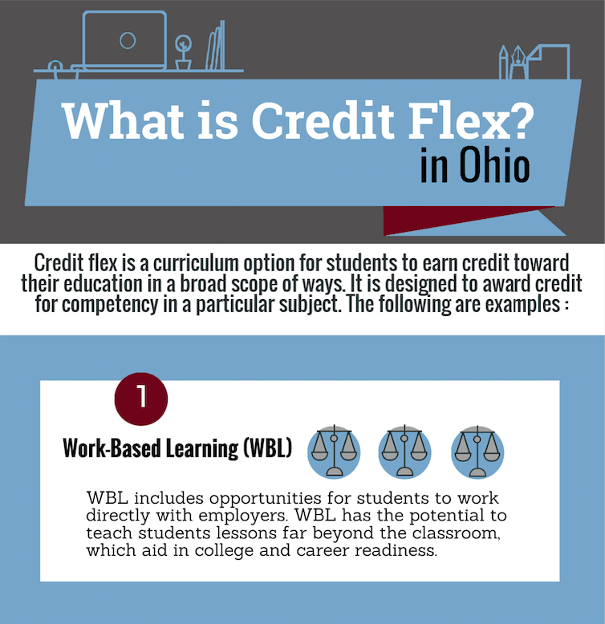
Notes:
While using OhioMeansJobs K-12 is not required, it is encouraged as a quality no-cost tool available to all districts. Online training and support materials are available on the dept’s website.
The dept has also development sample pathway documents that help align education and training to related careers. These pathways can be customized according to school course offerings as well as individual student plans for high school and beyond.

Slide 19
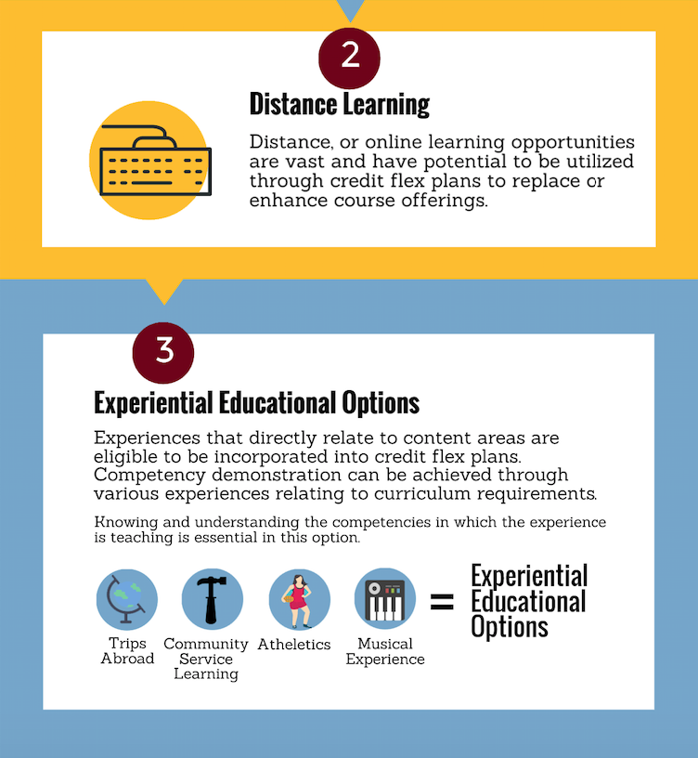
Notes:
While using OhioMeansJobs K-12 is not required, it is encouraged as a quality no-cost tool available to all districts. Online training and support materials are available on the dept’s website.
The dept has also development sample pathway documents that help align education and training to related careers. These pathways can be customized according to school course offerings as well as individual student plans for high school and beyond.

Slide 20
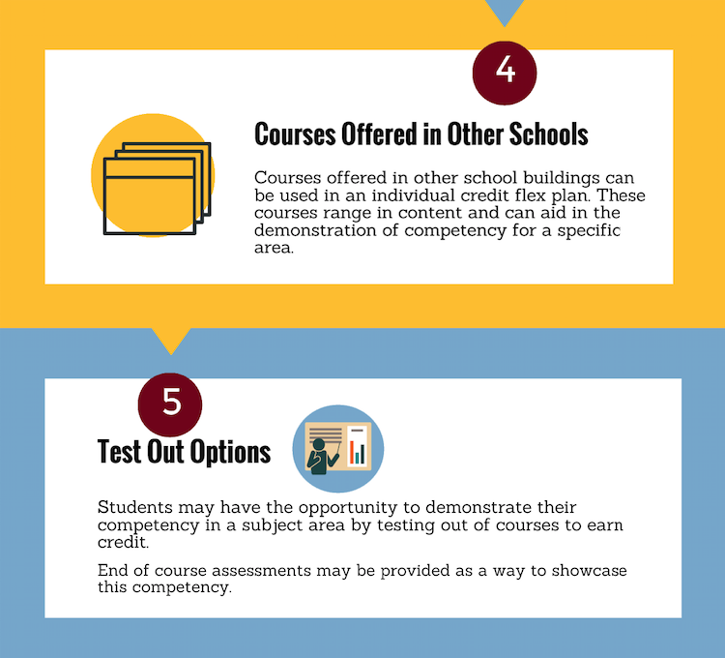
Notes:
While using OhioMeansJobs K-12 is not required, it is encouraged as a quality no-cost tool available to all districts. Online training and support materials are available on the dept’s website.
The dept has also development sample pathway documents that help align education and training to related careers. These pathways can be customized according to school course offerings as well as individual student plans for high school and beyond.

Slide 21
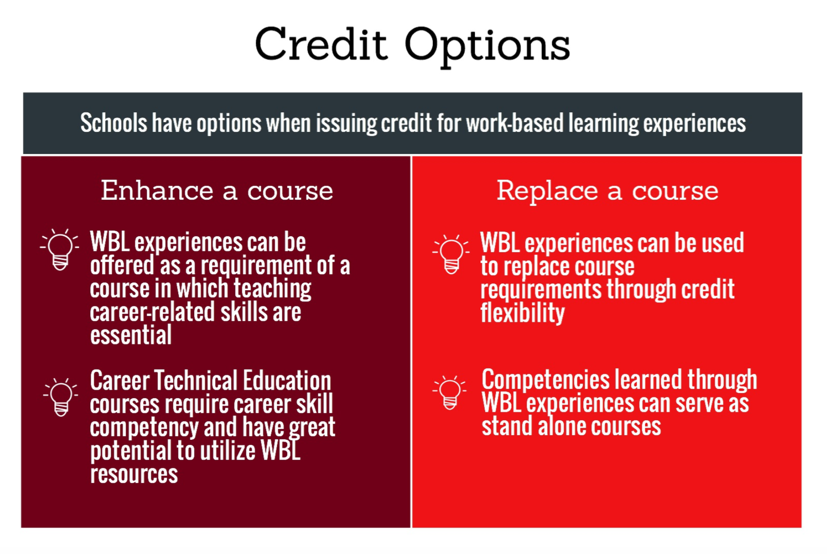
Utilizing Credit Flexibility
Notes:
While using OhioMeansJobs K-12 is not required, it is encouraged as a quality no-cost tool available to all districts. Online training and support materials are available on the dept’s website.
The dept has also development sample pathway documents that help align education and training to related careers. These pathways can be customized according to school course offerings as well as individual student plans for high school and beyond.

Slide 22
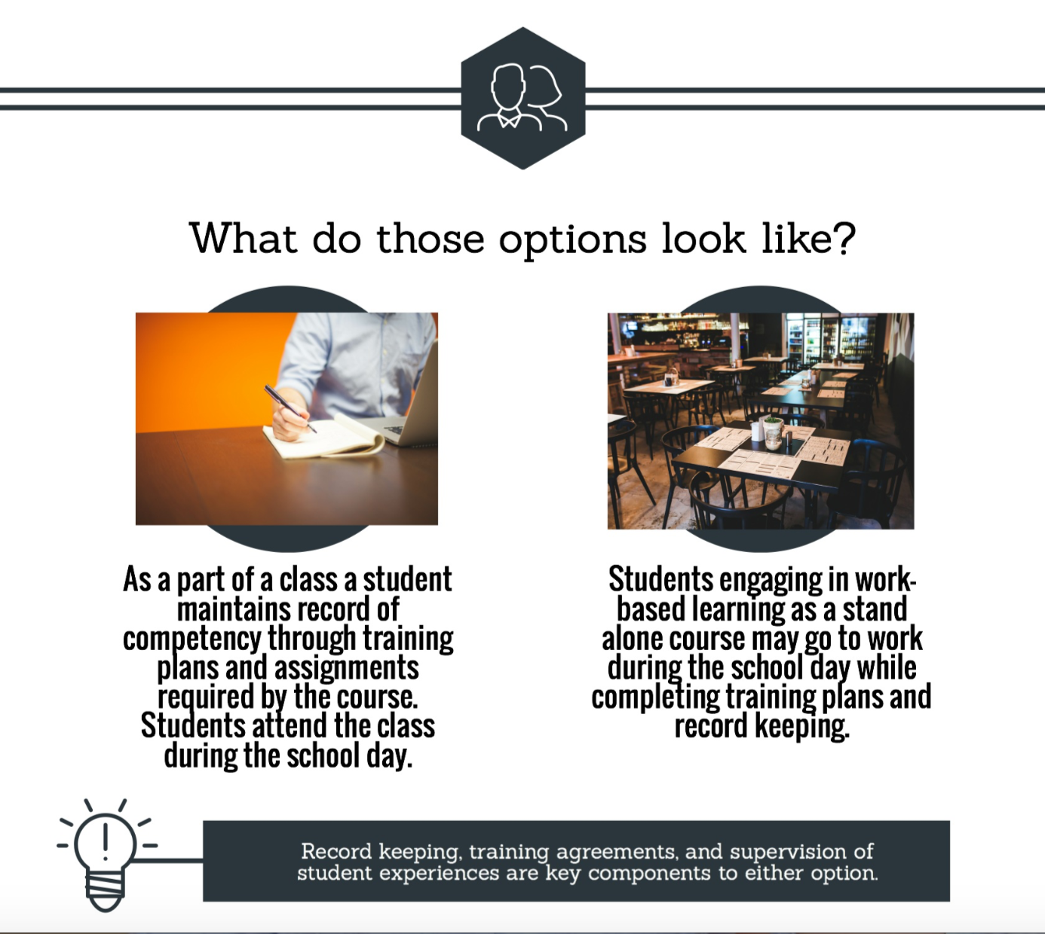
Notes:
While using OhioMeansJobs K-12 is not required, it is encouraged as a quality no-cost tool available to all districts. Online training and support materials are available on the dept’s website.
The dept has also development sample pathway documents that help align education and training to related careers. These pathways can be customized according to school course offerings as well as individual student plans for high school and beyond.

Slide 23
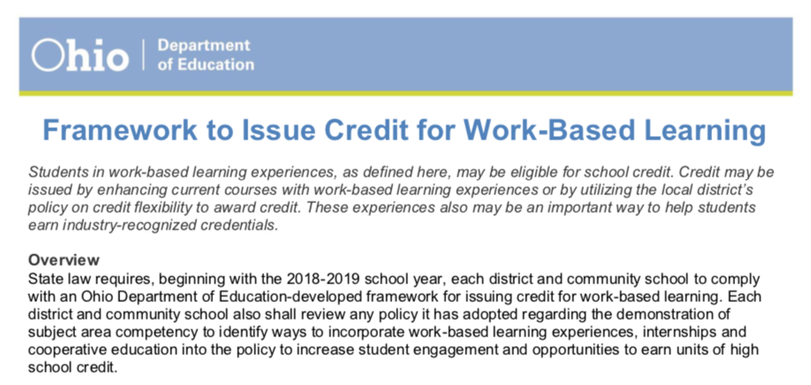
Notes:
While using OhioMeansJobs K-12 is not required, it is encouraged as a quality no-cost tool available to all districts. Online training and support materials are available on the dept’s website.
The dept has also development sample pathway documents that help align education and training to related careers. These pathways can be customized according to school course offerings as well as individual student plans for high school and beyond.

Slide 24

Integrated Courses
More time in schedule
Relevancy
Experiential opportunities
Notes:
Research supports that students who participate in integrated courses, (1) have more time in their schedule to earn college credit and industry credentials, (2) learn academic content in a relevant context and, (3) can participate in experiential learning.

Slide 25
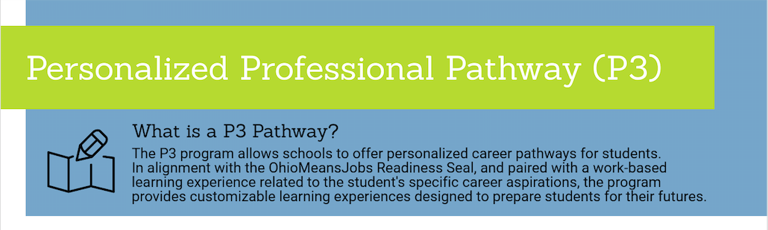
P3 – Personalized Professional Pathways
Notes:
While using OhioMeansJobs K-12 is not required, it is encouraged as a quality no-cost tool available to all districts. Online training and support materials are available on the dept’s website.
The dept has also development sample pathway documents that help align education and training to related careers. These pathways can be customized according to school course offerings as well as individual student plans for high school and beyond.

Slide 26
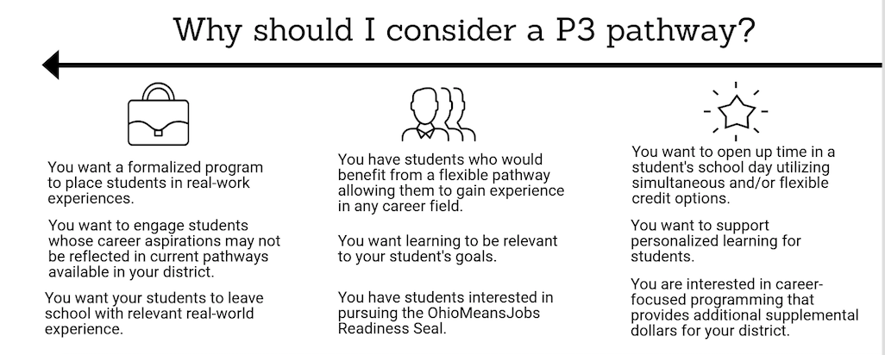
Notes:
While using OhioMeansJobs K-12 is not required, it is encouraged as a quality no-cost tool available to all districts. Online training and support materials are available on the dept’s website.
The dept has also development sample pathway documents that help align education and training to related careers. These pathways can be customized according to school course offerings as well as individual student plans for high school and beyond.

Slide 27

Aligned to the OhioMeansJobs Readiness Seal
Notes:
While using OhioMeansJobs K-12 is not required, it is encouraged as a quality no-cost tool available to all districts. Online training and support materials are available on the dept’s website.
The dept has also development sample pathway documents that help align education and training to related careers. These pathways can be customized according to school course offerings as well as individual student plans for high school and beyond.

Slide 28


OhioMeansJobs Readiness Seal:
Ohio Department of Education Information

Slide 29









OhioMeansJobs-Readiness Seal

Slide 30
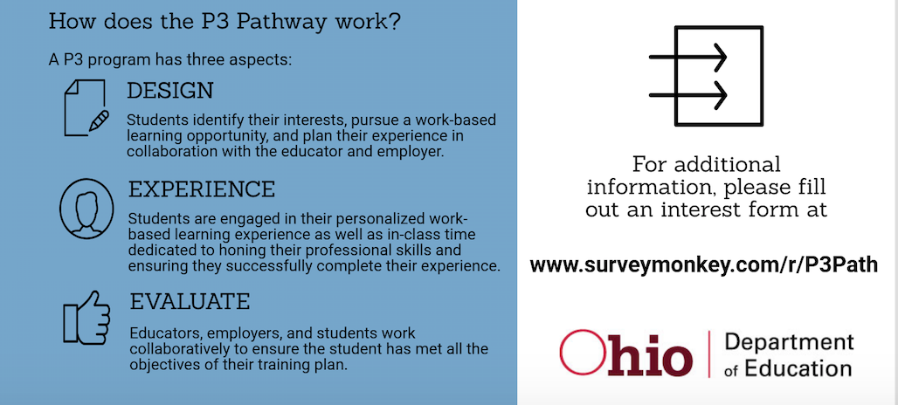
Notes:
While using OhioMeansJobs K-12 is not required, it is encouraged as a quality no-cost tool available to all districts. Online training and support materials are available on the dept’s website.
The dept has also development sample pathway documents that help align education and training to related careers. These pathways can be customized according to school course offerings as well as individual student plans for high school and beyond.

Slide 31
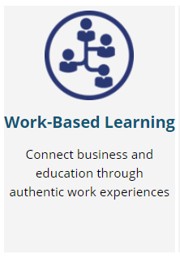
Work-Based Learning:
Utilize the
Ohio Department of Education Toolkit!

Slide 32
How do I start?

Slide 33
Needs Assessment

Slide 34
Use your Business Advisory Council

Slide 35
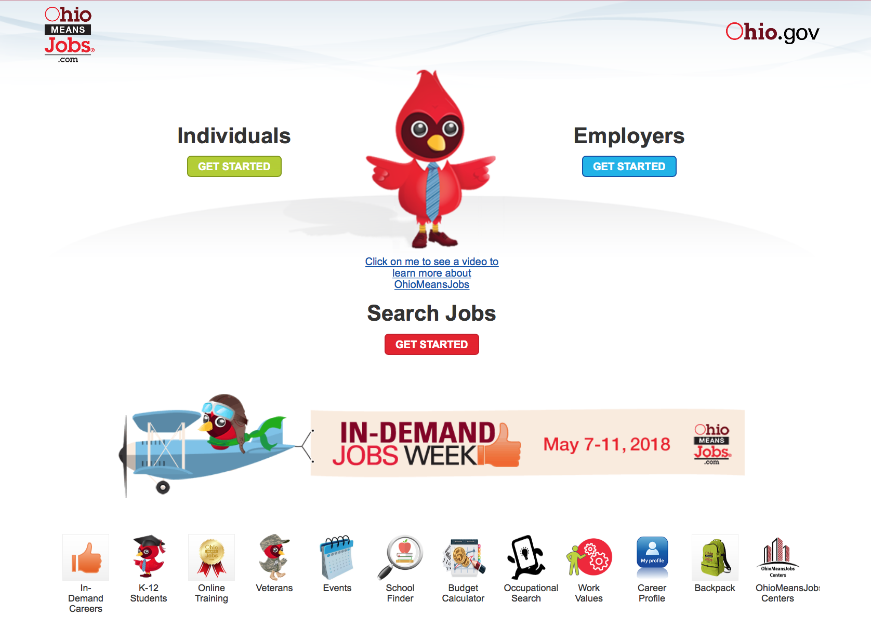
Notes:
While using OhioMeansJobs K-12 is not required, it is encouraged as a quality no-cost tool available to all districts. Online training and support materials are available on the dept’s website.
The dept has also development sample pathway documents that help align education and training to related careers. These pathways can be customized according to school course offerings as well as individual student plans for high school and beyond.

Slide 36
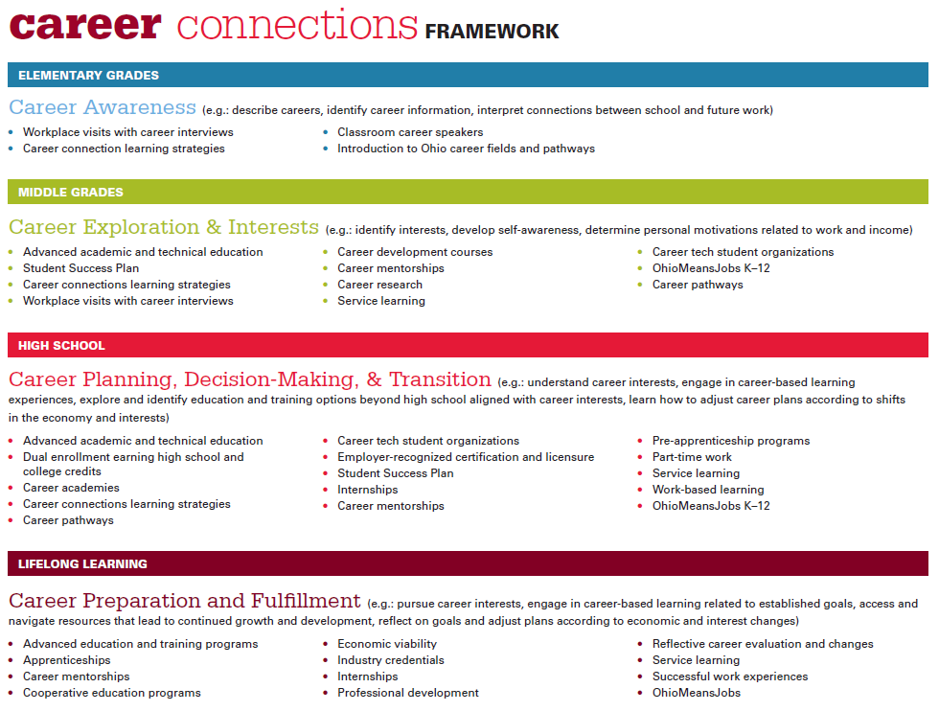
Notes:
Page two includes strategies at each level that include academic curriculum, experiential learning, and career education. Students need opportunities within a structured and supported environment to explore their options and try things out to find out more about what they like and don’t like.
College is expensive – any way you look at it. Regardless of a families ability to pay for education beyond high school, the cost is high. Career Connections is about providing kids opportunities to sample more things and get a better idea of the career fields that interest them. This is not about nailing down exact career choices - we know that isn’t realistic. But students should recognize before they leave high school that engineering is science-intense curriculum, becoming a veterinarian requires 8-10 years of schooling and that there are viable career options that require less than a four-year degree. This happens in classrooms across the state every day – this is about gelling all of the efforts to create a cohesive experience for students.

Slide 37
Connect with Us
education.ohio.gov/CareerConnections
Cassandra.Palsgrove@education.ohio.gov
Notes:
This concludes the overview on the career advising policy. As we work together to prepare all students for successful futures, additional resources and supports will be available from the department.
Local boards of education should begin developing a policy on career advising to adopt by the start of the 2015-2016 school year. Once your policies have been adopted, upload the policy in the compliance web system. The deadline for uploading the Career Advising Policy is Sep. 30.
Find a help document on the “User Manuals and Forms” tab on the Compliance Dashboard’s Career Advising page. For questions please contact Kayla M. Mack, Career Connections Consultant, at (614) 466-4235.
The department will review policies and include exemplars in an online clearinghouse for career advising strategies.
In addition, the department will continue to add tools and resources to the Career Connections webpage, available at http://education.ohio.gov/CareerConnections. In the meantime, be sure to review the existing Career Connections Framework, Career Connections Learning Strategies, and OhioMeansJobs K-12.
And look for a series of regional professional development sessions beginning Summer 2015.

